Slide 1
FNDB020 LECTURE 3
ACCOUNTING FOR TRANSACTIONS
FUNDAMENTALS PART 2

Slide 2
LEARNING OUTCOMES
The Accounting cycle
General Journal (revisit)
General ledger
Trial balance

Slide 3
The Accounting Cycle
Steps in the cycle
Accounting records
✔
Recognise and record all business transactions
refer to all Source documents
➔
in the General Journal
Journalise transactions
Post to ledger accounts
in the General Ledger
Prepare a Trial Balance
Trial Balance
Prepare the Financial Statements
Financial Statements

Slide 4
The Accounting Equation Task 2 Debit and Credit Rules
DR CR
ASSETS
=
LIABILITIES
+
EQUITY
Asset Accounts
(debit) - (credit)
Liability Accounts
(debit) (credit)
decrease increase
- +
Capital Account
(debit) (credit)
Income Accounts
(debit) (credit)
decrease increase
decrease increase
increase decrease
+ -
decrease increase
- +
decrease increase
- +
Drawings Accounts
(debit) (credit)
Expense Accounts
(debit) (credit)
increase decrease
Increase decrease
Notes:
BUILD SLIDE
A credit in accounting has no meaning – it is an accounting term only. Same debit. One is not positive and one is not negative Just remember DEBITS on the Left, CREDITS on the right. Follow these rules
An increase in the value of assets is a debit to the account, and a decrease is a credit. An increase is a debit because something must be due for that increase (the price of the asset).
On the other side, an increase in liabilities or owner's equity is a credit to the account, because it signifies an amount that someone else has entrusted (loaned) to you and which you used to purchase something (the cause of the corresponding debit in the assets account).
A decrease in liabilities or owner's equity is a debit.
the terms "debit" and "credit" signify actual accounting functions, both of which cause increases and decreases in accounts, depending on the type of account.
NOTE: notice that a credit can be + or – depending on the type of transaction And a debit can be + or –

Slide 5
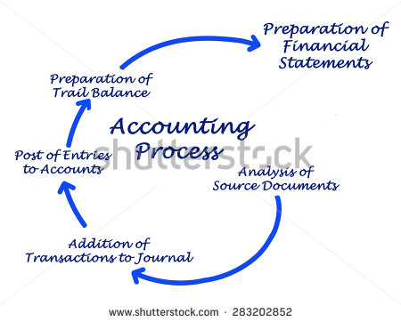
3 General Journal: The book of original entry
The General Journal is where all the original entries are recorded.
It is a diary of business events or transactions that capture the operating decisions made for the business.
Let’s look at how we “journalise” entries.

Slide 6
GENERAL JOURNAL
Once analysed a transaction is recorded first in the general journal
A journal has the following advantages:
Complete record of all transactions
Presented in chronological order
Useful for locating and reducing errors as debits and credits shown together

Slide 7
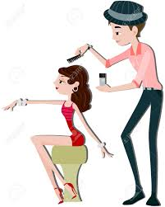
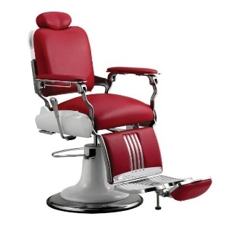
4 Justin’s Hair Studio: Journal entry
Justin paid $100,000 cash to invest into his new hair studio business.
He buys 3 barber chairs at $1,000 each and pays 20% deposit at the time of purchase. He agrees to pay the balance at a later date (he owes creditors).
Let’s see how these transactions affect the assets, liabilities and equity (income and expenses).

Slide 8
Event 1. Justin invests $100,000 in his new business
Notes:
SLIDE BUILD X 6
Justin puts in $300000. Which accounts will be affected?
Remind students that there will always be at least two affected accounts per transaction.
Elicit the second account (capital under equity).
Before showing rest of slide, ask students for the direction of money flow ie asset will go up (increased) so what happened to equity?

Slide 9
Event 2. Purchase of 3 Barber chairs
Notes:
Put this in the workbook. Lecturer does on whiteboard

Slide 10

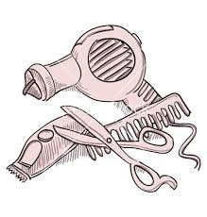

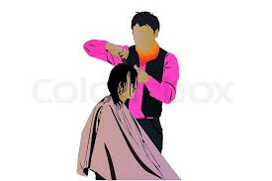
Justin’s hair studio: Journal Entry
Justin now buys more equipment…
He buys 35 pairs of cutting scissors at $50 each and pays the full amount in cash.
He buys 15 hairdryers at $100 each from his friend, Bob. At delivery, Bob agrees that Justin can make the payment 3 months later.

Slide 11
Event 3. Purchase of Scissors with cash

Slide 12
Event 4. Purchase of 15 hairdryers on credit
Notes:
Check that students understand the term “buying on credit”

Slide 13




Justin’s hair studio Journal Entry: Prepaid for a 12-month magazine subscription
Justin subscribed for a professional hairdressing magazine for one year. He paid the annual fee ($120).
Justin borrowed $5,000 from the Commonwealth Bank for his hair studio.

Slide 14
5. Purchase of 12-month Subscription

Slide 15
6. Loan approved for $5,000

Slide 16
General JOURNAL

Slide 17
General JOURNAL

Slide 18
POSTING FROM JOURNAL TO LEDGER
General journal records each transaction
General ledger records effect transactions on each individual account
Think of journal as an instruction – which accounts are changing, which direction and by how much?
In a computerised system
Posting is automated
Therefore it is important that the initial entries are correct
Debits and credit automatically checked for equality

Slide 19
GENERAL JOURNAL: summarising
For every transaction, a complete journal entry has the following:
The date of the transaction;
The accounts and amounts to be debited and credited;
Each transaction affects at least two accounts
A brief explanation of the transaction, referred to as a narration;

Slide 20
The Accounting Cycle
Steps in the cycle
Accounting records
✔
Recognise and record all business transactions
refer to all Source documents
✔
Journalise transactions
in the General Journal
➔
Post to ledger accounts
in the General Ledger
Prepare a Trial Balance
Trial Balance
Prepare the Financial Statements
Financial Statements

Slide 21
General Ledger: Posting from Journal to Ledger
The next process in the accounting cycle is to post all journal entries to the General Ledger.
The Ledger sorts journal entries into transactions of the same labelled account (e.g. all Cash at Bank transactions are collected and reported under one heading)
Let’s look at how the ledger works. Back to the Workbook Exercise

Slide 22
1. Justin invests in the business

Slide 23
2. Purchase of 3 Barber Chairs
Notes:
SLIDE BUILD

Slide 24
3. Purchase of Scissors with cash

Slide 25
4. Purchase of 15 blow dryers on credit

Slide 26
5. Purchase of 12-month Subscription

Slide 27
6. Loan approved for $5,000

Slide 28
A = L + E

Slide 29
5 Income and Expense transactions
The business will have numerous transactions that involve the earning of income and the payment of expenses over its operating life.
With Justin’s Hairdressing business how does he earn income for the business?
What are some typical expenses he will incur each week or month?

Slide 30
6 Apply your learning. Some simple transactions involving all 5 elements.
1/5 Owner Jack invested $50,000 cash and a vehicle worth $20,000 into his “Geelong Cleaning” business
2/5 Purchase for cash cleaning equipment for $10,000
3/5 A customer paid Justin $200 for cleaning their house
4/5 Justin paid rent on a warehouse to store equipment of $500 for the month
5/5 Justin paid for the electricity account which was $120 for the month
6/5 A customer had $300 cleaning and has agreed to pay in 1 month.
7/5 Purchased a vacuum cleaner for $1000 on credit from Harvey Norman

Slide 31
Transaction analysis
Date | Assets | Liabilities | Owner’s Equity (+ income – Expense)

Slide 32
General Journal
Date | Details | Debit | Credit

Slide 33
The Accounting Cycle
Steps in the cycle
Accounting records
✔
Recognise and record all business transactions
refer to all Source documents
✔
Journalise transactions
in the General Journal
✔
Post to ledger accounts
in the General Ledger
➔
Prepare a Trial Balance
Trial Balance
Prepare the Financial Statements
Financial Statements

Slide 34
7 TRIAL BALANCE
Lists all ledger accounts and their balances
Debits in one column, credits in another
The totals of both columns must be equal
If this is the case, the ledger ‘balances’
Limitations of the trial balance
May balance but still contain errors
If it doesn’t balance there is definitely an error but it doesn’t tell you what the error is

Slide 35
TRIAL BALANCE: uses and benefits
Provides a check on the accuracy of the posting process (debits and credits) from the journals to the ledger accounts.
Can be prepared at any time along the accounting cycle to test that the debit balance equals the credit balance in the ledger.
It is not error proof (human errors made) e.g. if incorrect amounts, debiting instead of crediting, recording an incorrect figure e.g. $76 instead of $67.
Do Task 8 in your workbook

Slide 36
9 Extension work. Do a simple Income statement and Balance Sheet for Jack.

Slide 37
Tutorial Week 3
See Workbook for tasks 3.7, 3.9
Kahoot Week 3
Glossary update

